Slide 1
Module 2
Information Retrieval Models

Slide 2
Formal Characteristics of IR Models
Help to define their behavior, performance, and applicability to various retrieval tasks.
These characteristics can be used to compare and evaluate different IR models.
1. Representation
Document Representation: How documents are represented within the model (e.g., as vectors, probabilistic distributions, or networks).
Query Representation: How user queries are represented and processed within the model.
Feature Space: The set of features or dimensions used to represent documents and queries (e.g., terms, phrases, concepts).
2. Matching Function
Relevance Calculation: The method used to calculate the relevance of a document to a query (e.g., cosine similarity, probability estimation).
Scoring Mechanism: The algorithm used to assign scores to documents based on their relevance to the query.
Normalization: Techniques used to normalize scores to make them comparable across different documents and queries.

Slide 3
3. Ranking
Ranking Algorithm: The process used to order documents based on their relevance scores.
Rank Aggregation: Methods for combining multiple relevance scores or rankings into a final ranking (e.g., in meta-search engines like Dogpile,Trivago etc.).
4. Retrieval Model Basis
Theoretical Foundation: The underlying theory or mathematical basis of the model (e.g., probability theory, vector space theory, neural networks).
Assumptions: The assumptions made by the model about the data and the retrieval process (e.g., term independence in the Vector Space Model).
5. Efficiency
Computational Complexity: The computational resources required to process queries and retrieve documents (e.g., time complexity, space complexity).
Indexing Requirements: The type and structure of indexes needed to support efficient retrieval.

Slide 4
6. Effectiveness
Precision and Recall: Metrics used to evaluate the accuracy of the retrieval model in returning relevant documents.
F-measure: A combined metric of precision and recall to assess the overall effectiveness of the model.
Mean Average Precision (MAP): A measure of the precision of the top-ranked documents across multiple queries.
Normalized Discounted Cumulative Gain (NDCG): A measure of ranking quality, considering the position of relevant documents in the result list.
7. Adaptability
Relevance Feedback: The ability of the model to incorporate user feedback to improve retrieval performance.
Query Expansion: Techniques to enhance the original query with additional terms or concepts.
Personalization: The ability to tailor retrieval results based on user preferences and behavior.

Slide 5
8. Robustness
Noise Tolerance: The model's ability to handle noisy or irrelevant data.
Scalability: The model's performance when handling increasing amounts of data or larger query loads.
Generalization: The model's capability to perform well across different types of data and retrieval tasks.
9. Interpretability
Transparency: The ease with which users can understand how relevance scores are assigned and how results are generated.
Explanation: The model's ability to provide explanations for why certain documents are retrieved or ranked higher.
10. Flexibility
Model Extensions: The ability to extend or modify the model to incorporate new data types, features, or retrieval tasks.
Integration: The model's compatibility with other retrieval models or systems.

Slide 6
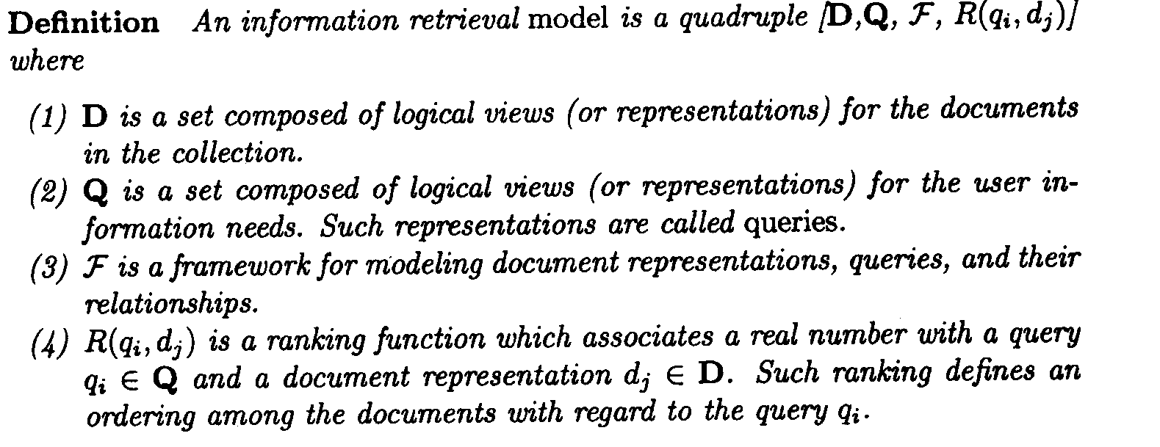
Formal Characterization of IR Models

Slide 7
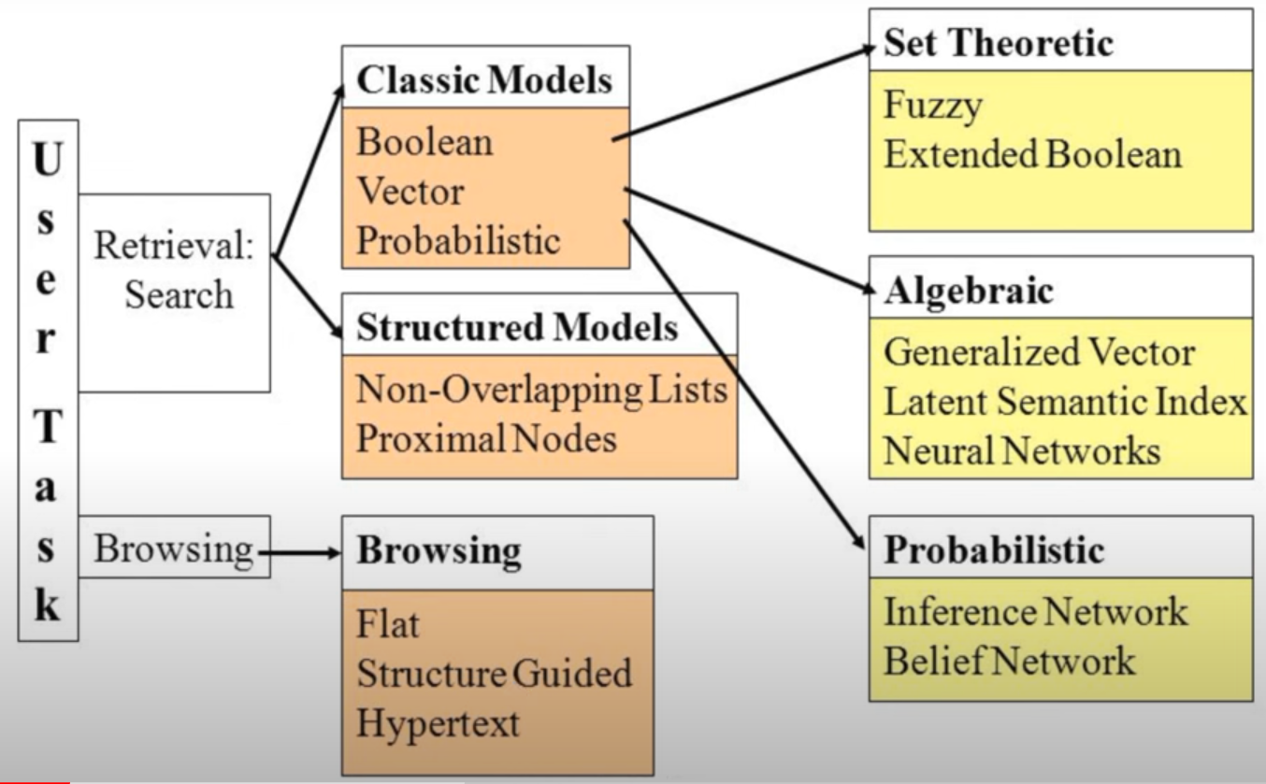
Taxonomy of Information Retrieval Models

Slide 8
Taxonomy of Information Retrieval Models
1. Classical Models
Boolean Model: Represents documents and queries as sets of index words. Hence model is set theoretic.
Vector Space Model: Represents documents and queries as vectors in a multidimensional space. Hence model is Algebraic.
Probabilistic Model: The framework for modeling documents and query representation is based on probability theory. Hence model is probabilistic.
2. Structured Models
Extended Boolean Model: Enhances the Boolean model by incorporating partial matching and term weighting.
Fuzzy Set Model: Uses fuzzy logic to handle the vagueness and ambiguity in information retrieval, allowing partial membership.

Slide 9
Taxonomy of Information Retrieval Models
1. Classical Models
Boolean Model: Represents documents and queries as sets of index words. Hence model is set theoretic. Uses Boolean logic (AND, OR, NOT) to match documents with queries. Documents are either relevant or not, with no ranking.
Vector Space Model: Represents documents and queries as vectors in a multidimensional space. Relevance is determined by the cosine similarity between document and query vectors.
Probabilistic Model: Estimates the probability that a document is relevant to a query based on prior probability and document features.
2. Structured Models
Extended Boolean Model: Enhances the Boolean model by incorporating partial matching and term weighting.
Fuzzy Set Model: Uses fuzzy logic to handle the vagueness and ambiguity in information retrieval, allowing partial membership.

Slide 10
Taxonomy of Information Retrieval Models
3. Language Models
Query Likelihood Model: Assumes a document is relevant if it has a high probability of generating the query.
Document Likelihood Model: Assumes queries are generated from relevant documents and ranks documents based on the likelihood of generating the query.
4. Bayesian Network Models
Simple Bayesian Network: Uses Bayesian inference to model the relationships between documents, terms, and relevance.
Inference Network Model: Constructs a network of nodes representing queries, terms, and documents, using probabilistic inference to determine relevance.

Slide 11
Taxonomy of Information Retrieval Models
5. Latent Semantic Models
Latent Semantic Analysis (LSA): Reduces dimensionality by identifying latent concepts in documents and queries through Singular Value Decomposition (SVD).
Latent Dirichlet Allocation (LDA): Assumes documents are mixtures of topics, and each topic is a distribution over words, using probabilistic modeling to uncover these topics.
6. Neural Network Models
Deep Learning Models: Utilize neural networks, such as Convolutional Neural Networks (CNNs) and Recurrent Neural Networks (RNNs), to capture complex patterns and semantics in text.
Transformer-Based Models: Use architectures like BERT and GPT to understand context and semantics through attention mechanisms.

Slide 12
Taxonomy of Information Retrieval Models
7. Hybrid Models
Combining Models: Integrate multiple retrieval models to leverage their strengths and mitigate weaknesses. For example, combining the vector space model with probabilistic elements.
Meta-Search Engines: Aggregate results from multiple search engines, applying different IR models to improve overall relevance.
8. Feedback and Adaptation Models
Relevance Feedback: Modifies the original query based on user feedback, improving retrieval performance iteratively.
Pseudo-Relevance Feedback: Automatically selects top-ranked documents from initial results to refine the query without explicit user feedback.

Slide 13
Taxonomy of Information Retrieval Models
9. Time-Based Models
Temporal IR: Incorporates the temporal aspects of documents and queries, focusing on the freshness and timeliness of information.
10. Graph-Based Models
PageRank: Uses link analysis to determine the importance of web pages, ranking them based on their connections.
HITS Algorithm: Identifies hubs and authorities in a network of documents to rank them based on their link structure.
Summary
Each IR model has its own strengths and weaknesses, making them suitable for different types of information retrieval tasks and contexts. The choice of model depends on the specific requirements of the retrieval system, the nature of the documents and queries, and the desired balance between precision and recall.

Slide 14
Classic IR Models
The three most well-known classic IR models are:
Boolean Model,
Vector Space Model, and
Probabilistic Model.

Slide 15
1. Boolean Model (Set Theoretic Model)
Description:
The Boolean Model is one of the simplest and earliest IR models.
It uses Boolean logic to represent documents and queries as sets of terms.
It relies on Boolean logic to match documents with user queries using a binary approach where documents are either relevant or not relevant based on the presence or absence of terms.
Queries are expressed using Boolean operators: AND, OR, and NOT.
Key Concepts
Boolean Logic:
AND: Retrieves documents that contain all the specified terms.
OR: Retrieves documents that contain at least one of the specified terms.
NOT: Excludes documents that contain the specified term.
Parentheses: Used to group terms and operators to form complex queries.
Document Representation:
Documents are represented as sets of terms (keywords).
Each term in the document is treated as a binary feature (either present or absent).
Query Representation:
Queries are formulated using Boolean expressions involving terms and Boolean operators (AND, OR, NOT).

Slide 16
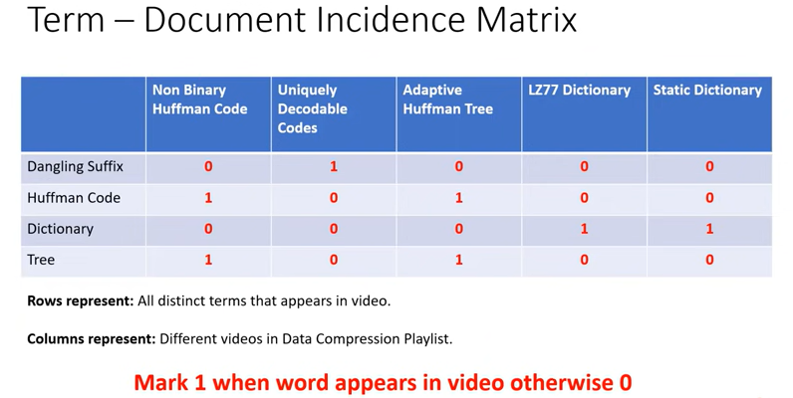

Slide 17
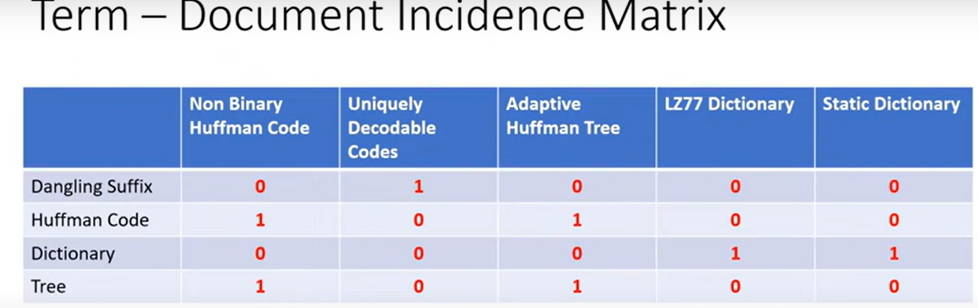
Our Query: HUFFMAN CODE AND TREE BUT NOT DANGLING SUFFIX 10100 AND 10100 AND 10111
Result: 10100 i.e Video 1 and 3 ( Non Binary Huffman Codes And Adaptive Huffman Tree)

Slide 18
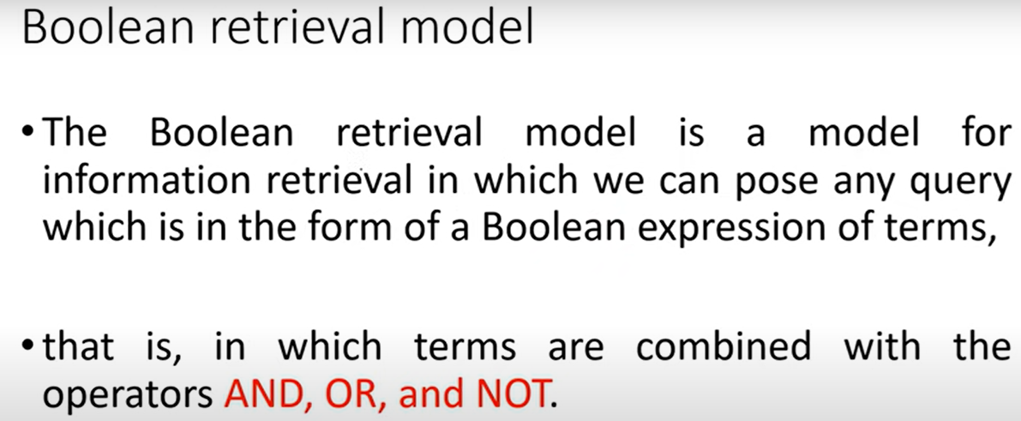

Slide 19
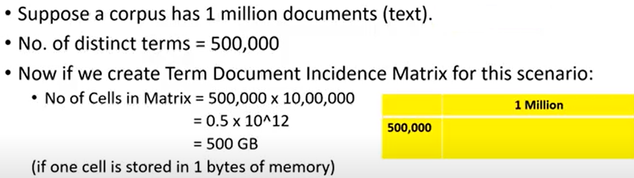
A More Realistic Scenario and Problem
Problem1:

Slide 20
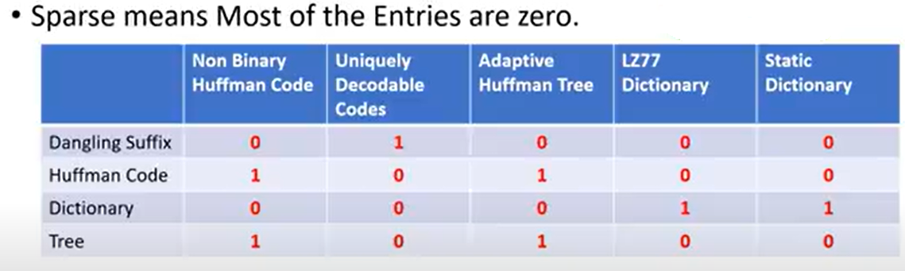
Problem 2: Term Document Matrix Is Sparse

Slide 21
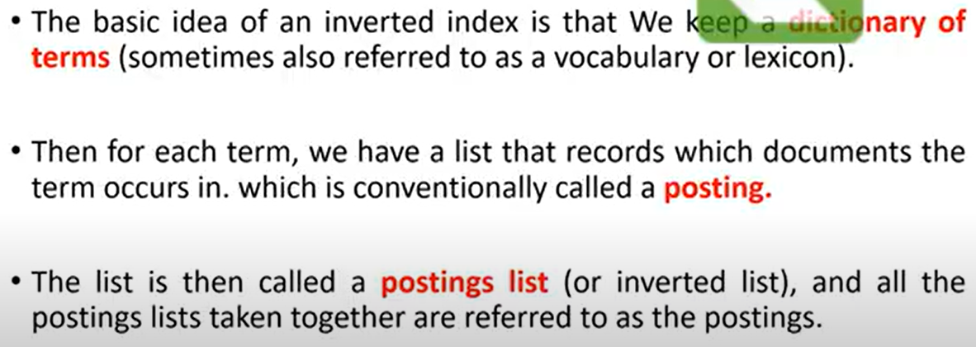
Inverted Index- Basic Idea

Slide 22
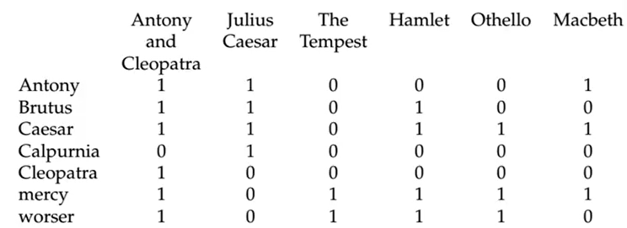

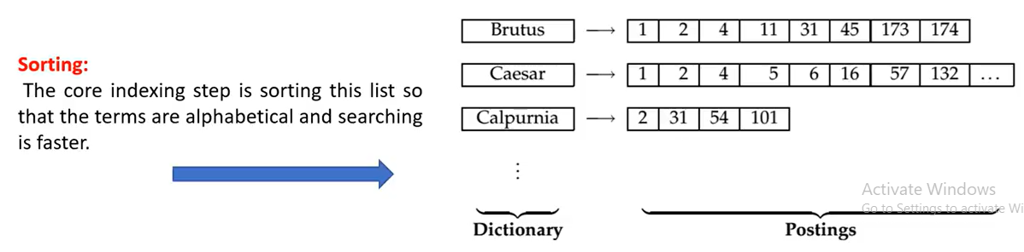
Example: Shakespeare’s Play
Each document is identified by docID, a serial no for document
We can apply Binary search for increasing searching speed)

Slide 23
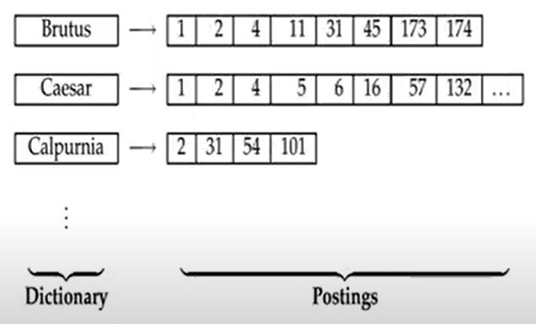
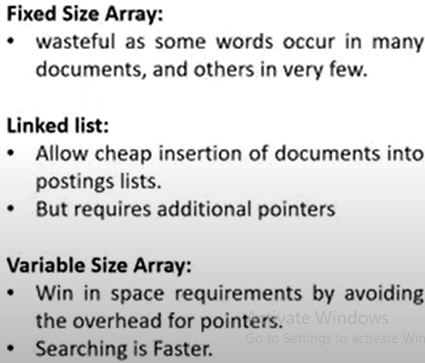
How to maintain this postings list in the memory?

Slide 24
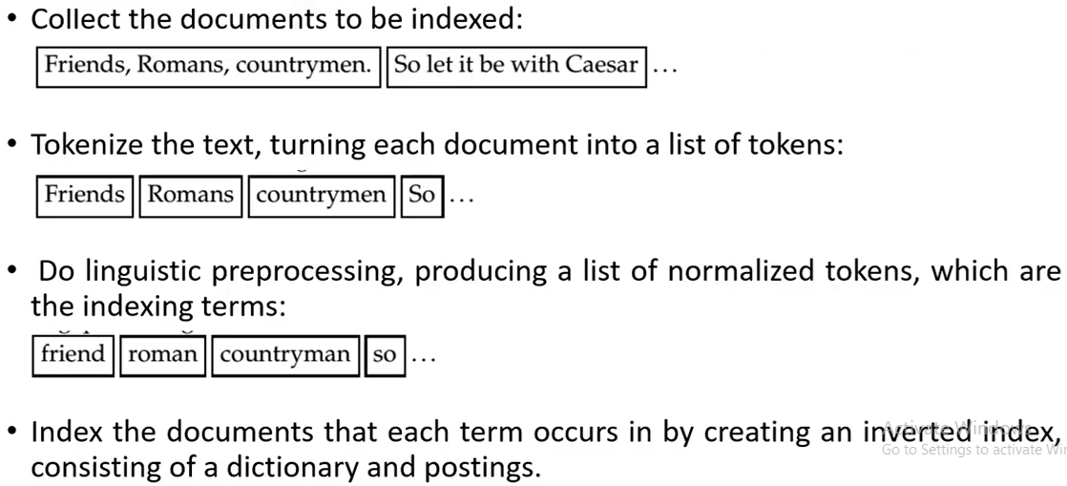
Building the inverted index : Steps
Convert each token to lowercase , find base word for each token

Slide 25
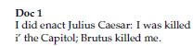
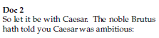
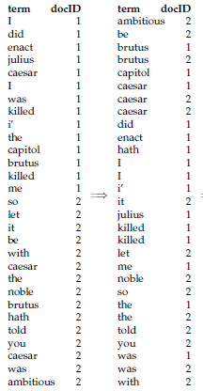
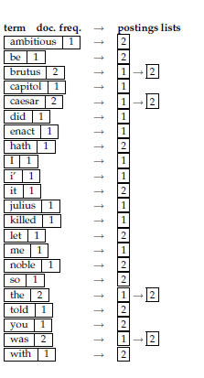
Example: Inverted Index
Figure : Building an index by sorting and grouping.

Slide 26
The dictionary stores the terms, and has a pointer to the postings list for each term.
It commonly also stores other summary information such as, here, the document frequency of each term.
We use this information for improving query time efficiency and, later, for weighting in ranked retrieval models.
Each postings list stores the list of documents in which a term occurs, and may store other information such as the term frequency (the frequency of each term in each document) or the position(s) of the term in each document

Slide 27
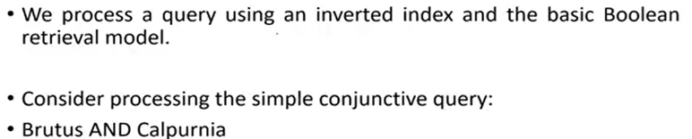
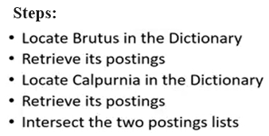
Processing Boolean Queries

Slide 28
Example: Shakespeare’s Play
Each document is identified by docID, a serial no for document
We can apply Binary search for increasing searching speed)

Slide 29
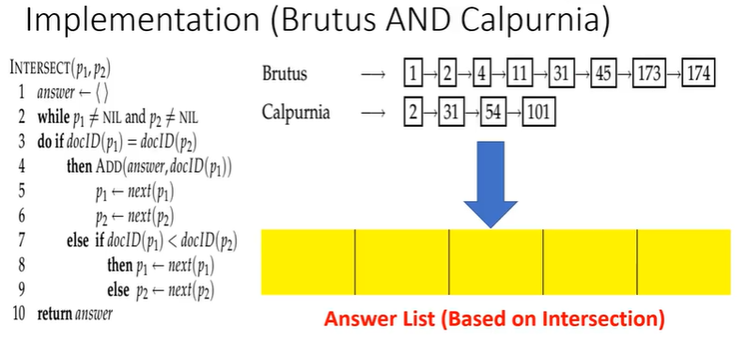
2
31

Slide 30
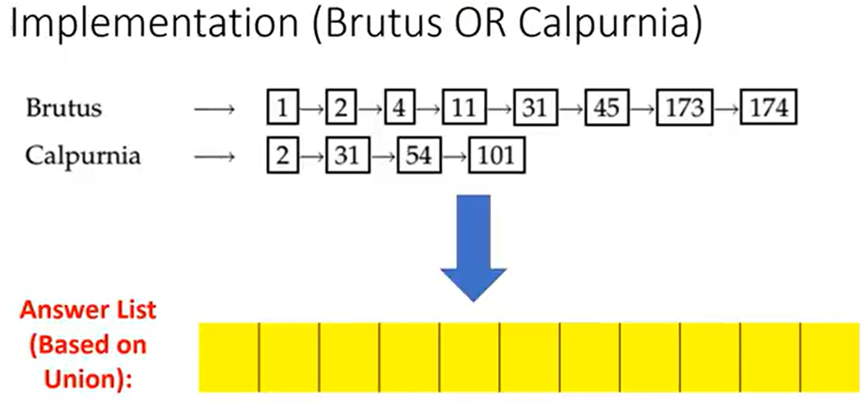
1
2
4
11
31
45
54
101
173
174

Slide 31
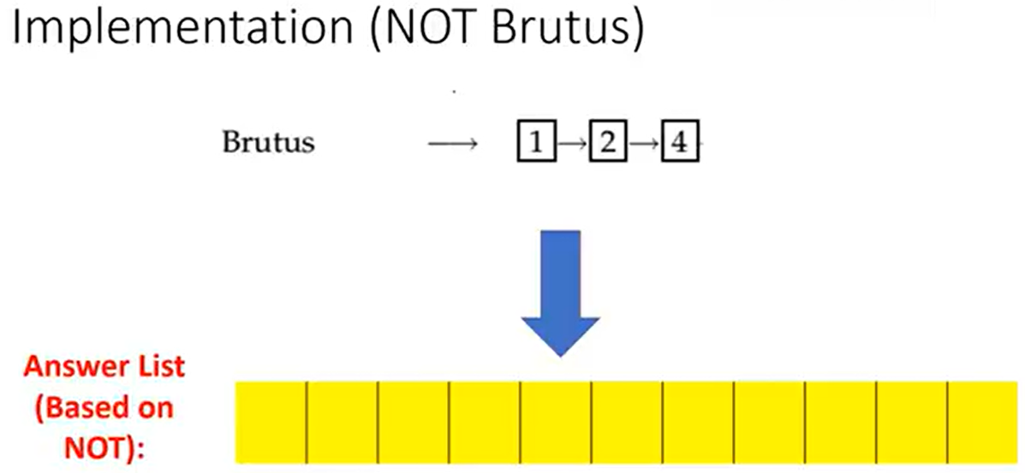
3

Slide 32

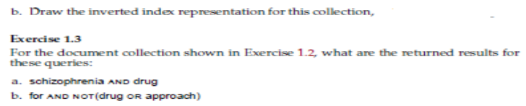

Slide 33
Boolean Model Advantages and Disadvantages
Advantages
Simplicity:
Easy to understand and implement.
Queries are straightforward to construct using Boolean operators.
Precise Matching:
Exact matching of query terms ensures that retrieved documents contain the specified terms.
Efficiency:
Efficient retrieval using inverted indexes.
Disadvantages
Binary Relevance:
No ranking or relevance scoring of documents; results are binary (relevant or not).
Does not consider partial matches or degrees of relevance.
Inflexibility:
Rigid query formulation may not capture the nuances of user information needs.
Complex queries can become cumbersome to construct and interpret.
Lack of Term Weighting:
All terms are treated equally, without considering term frequency or importance.
Handling Synonyms and Variants:
Cannot effectively handle synonyms, variants, or semantic relationships between terms.

Slide 34
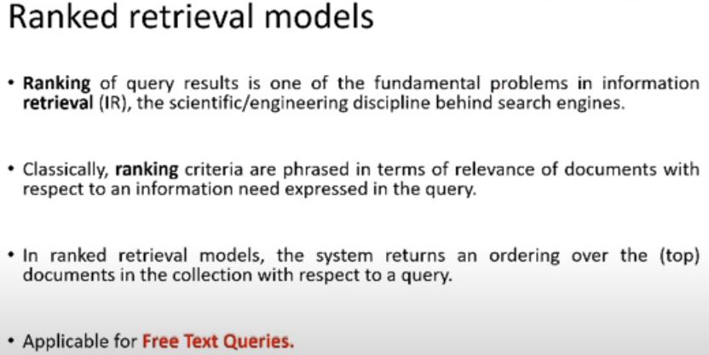
Ranked Retrieval Models

Slide 35
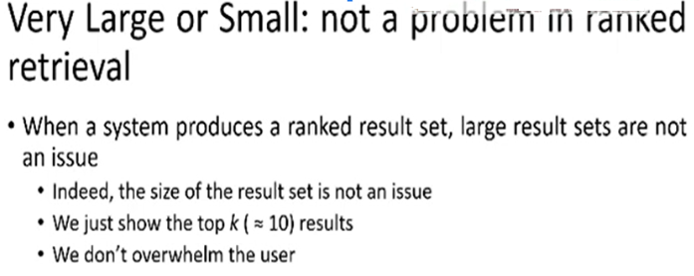

Slide 36
Scoring as a basis of Ranked Retrieval
We need to provide the searcher with the documents that are most likely to be useful to him.
How can we rank the retrieved documents based on its relevance to user query ?
Assign the score [0-1] to each document.

Slide 37
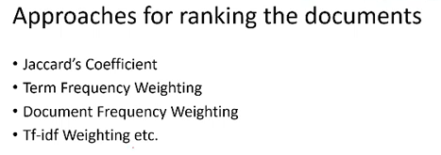

Slide 38
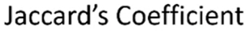
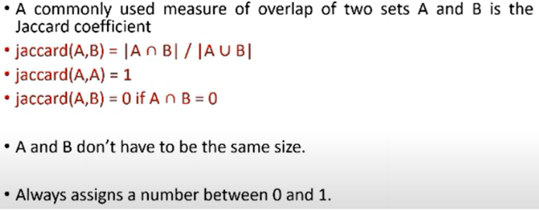

Slide 39
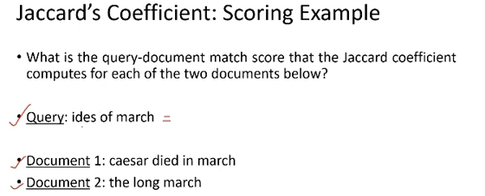
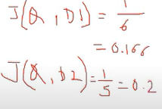
Here D2 is more relevant to Q.
But in real scenario, it is not true.(D1 is more relevant to Q and D2 has nothing to do with Q).
This is drawback of JC. Sometimes we get answers that are not relevant to Q

Slide 40
Jaccard’s Coefficient : Advantages and Disadvantages
Advantages:
Simple and easy to compute.
Works well for sets with distinct, non-repeating elements.
Useful for applications where presence or absence of terms is more important than their frequency.
Disadvantages:
Does not take into account term frequency; only presence or absence matters.
May not perform well with documents where the term frequency is important.
Can be less effective for large and sparse sets where the overlap may be minimal.
Use Cases
Jaccard's coefficient is often used in:
Document clustering: To measure the similarity between documents.
Plagiarism detection: To find overlapping content.
Recommendation systems: To compare user preferences or item features.
Bioinformatics: To compare genetic sequences or protein structures.
While Jaccard's coefficient is a useful similarity measure, it is often used in combination with other methods for more comprehensive ranking and retrieval tasks.

Slide 41
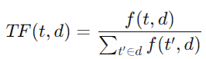
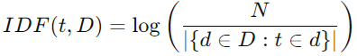
TF-IDF (Term Frequency-Inverse Document Frequency)
TF-IDF is a statistical measure used to evaluate the importance of a term in a document relative to a collection of documents (corpus).
It is widely used in information retrieval and text mining to rank and retrieve documents based on their relevance to a given query.
Term Frequency (TF)
Measures how frequently a term t appears in a document (importance of a term within the doc)
A higher term frequency indicates a more significant term within that document.
Common formula:
Where f(t,d) is the raw count of term t in document d, and the denominator is the total number of terms in document d.
Inverse Document Frequency (IDF)
Measures the importance of a term within the entire corpus.
A term that appears in fewer documents is considered more significant.
Common formula)

Slide 42
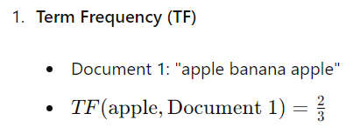
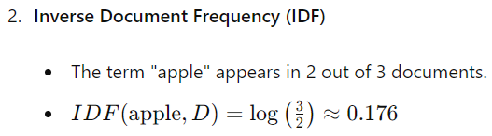
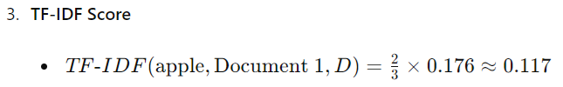
TF-IDF (Term Frequency-Inverse Document Frequency)
TF-IDF Score
Combines TF and IDF to compute a weight for each term in each document.
The weight reflects the importance of the term within the document and across the corpus.
Formula:
Example:
Consider a small corpus with three documents:
Document 1: "apple banana apple"
Document 2: "banana orange"
Document 3: "apple orange orange banana"
Calculate the TF-IDF for the term "apple" in Document 1.

Slide 43
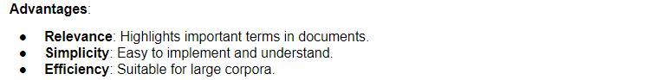
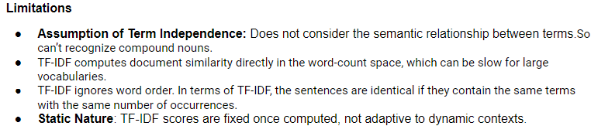

TF-IDF : Advantages and Disadvantages

Slide 44
Example 2:
Step 2: Calculate Inverse Document Frequency (IDF)
Compute the IDF for each term in the corpus.
IDF(apple) = log(3 / 2) ≈ 0.176
IDF(banana) = log(3 / 3) = 0
IDF(orange) = log(3 / 2) ≈ 0.176
Document 1: "apple banana apple"
Document 2: "banana orange"
Document 3: "apple orange orange banana"
User query: "apple banana"
Step 1: For each term in each document, compute the term frequency (TF)
Document 1:
TF(apple, Document 1) = 2 / 3 = 0.67
TF(banana, Document 1) = 1 / 3 = 0.33
Document 2:
TF(banana, Document 2) = 1 / 2 = 0.50
TF(orange, Document 2) = 1 / 2 = 0.50
Document 3:
TF(apple, Document 3) = 1 / 4 = 0.25
TF(orange, Document 3) = 2 / 4 = 0.50
TF(banana, Document 3) = 1 / 4 = 0.25
Step4: Query Representation
Represent the query "apple banana" using the TF-IDF scores.
Query:
TF(apple, Query) = 1 / 2 = 0.50
TF(banana, Query) = 1 / 2 = 0.50
TF-IDF(apple, Query) = 0.50 * 0.176 ≈ 0.088
TF-IDF(banana, Query) = 0.50 * 0 = 0
Step 3: Calculate TF-IDF
Multiply the TF by the IDF for each term in each document.
Document 1:
TF-IDF(apple, Document 1) = 0.67 * 0.176 ≈ 0.118
TF-IDF(banana, Document 1) = 0.33 * 0 = 0
Document 2:
TF-IDF(banana, Document 2) = 0.50 * 0 = 0
TF-IDF(orange, Document 2) = 0.50 * 0.176 ≈ 0.088
Document 3:
TF-IDF(apple, Document 3) = 0.25 * 0.176 ≈ 0.044
TF-IDF(orange, Document 3) = 0.50 * 0.176 ≈ 0.088
TF-IDF(banana, Document 3) = 0.25 * 0 = 0
Note: When calculating TF-IDF for the terms in a query, we're essentially treating the query as a document and comparing it to the entire corpus. However, the IDF is calculated based on the corpus, not the query itself.

Slide 45
Vector Space Model
The vector model recognizes that the use of binary weights is too limiting and proposes a framework in which partial matching is possible.
This is accomplished by assigning non-binary weights to index terms in queries and in documents.
These term weights are ultimately used to compute the degree of similarity between each document stored in the system and the user query.
By sorting the retrieved documents in decreasing order of this degree of similarity, the vector model takes into consideration documents which match the query terms only partially.
It allows for more flexible and nuanced retrieval compared to the Boolean model, as it considers the similarity between the query vector and document vectors rather than exact matches of terms.
The Vector Space Model (VSM) is a classic and widely used Information Retrieval (IR) model that represents documents and queries as vectors in a multi-dimensional space.

Slide 46
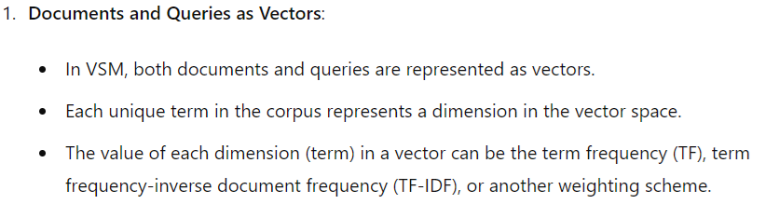
Vector Space Model
Key Concepts

Slide 47
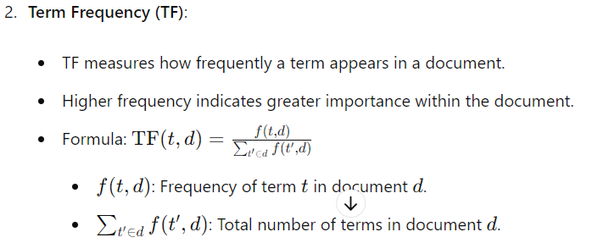
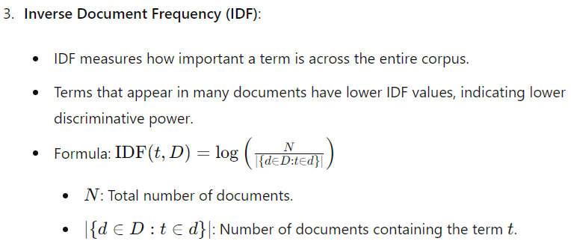

Slide 48
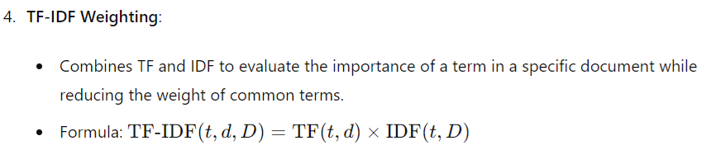
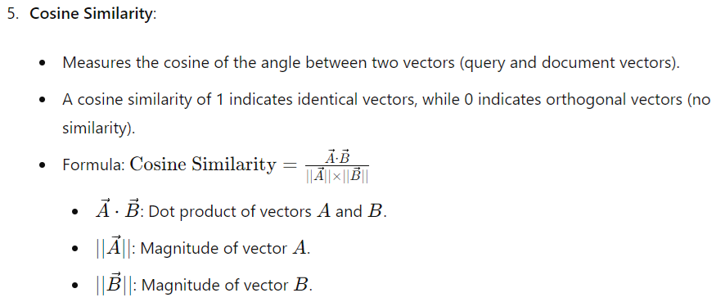

Slide 49
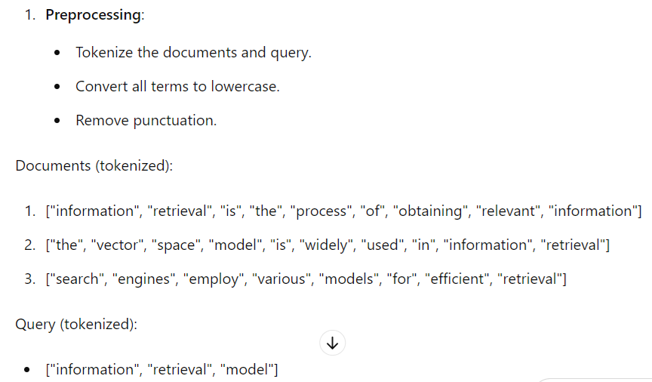
Example
Documents:
Document 1: "Information retrieval is the process of obtaining relevant information."
Document 2: "The Vector Space Model is widely used in information retrieval."
Document 3: "Search engines employ various models for efficient retrieval."
Query:
"information retrieval model"

Slide 50
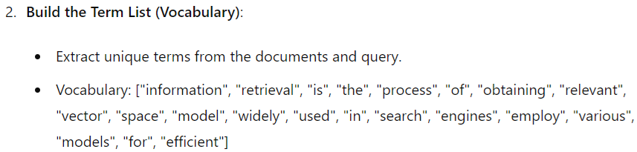
Documents:
Document 1: "Information retrieval is the process of obtaining relevant information."
Document 2: "The Vector Space Model is widely used in information retrieval."
Document 3: "Search engines employ various models for efficient retrieval."
Query:
"information retrieval model"
3. Calculate Term Frequency (TF):Calculate the term frequency for each term in each document and also for each query term.
Document 2 TF:
the: 1
vector: 1
space: 1
model: 1
is: 1
widely: 1
used: 1
in: 1
information: 1
retrieval: 1
Document 1 TF:
information: 2
retrieval: 1
is: 1
the: 1
process: 1
of: 1
obtaining: 1
relevant: 1
Document 3 TF:
search: 1
engines: 1
employ: 1
various: 1
models: 1
for: 1
efficient: 1
retrieval: 1
Query TF:
information: 1
retrieval: 1
model: 1

Slide 51
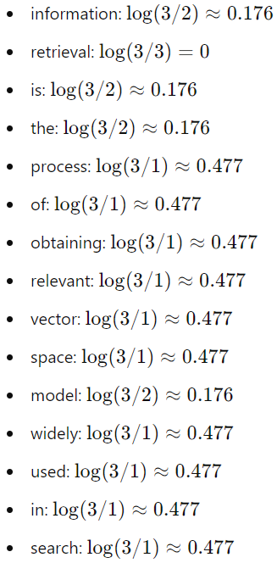
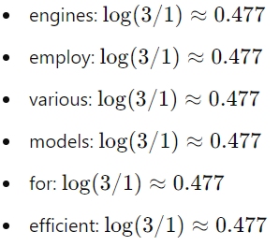
4. Calculate Inverse Document Frequency (IDF):
Calculate IDF for each term in the vocabulary
Total number of documents,N=3.
Documents:
Document 1: "Information retrieval is the process of obtaining relevant information."
Document 2: "The Vector Space Model is widely used in information retrieval."
Document 3: "Search engines employ various models for efficient retrieval."
Query:
"information retrieval model"

Slide 52
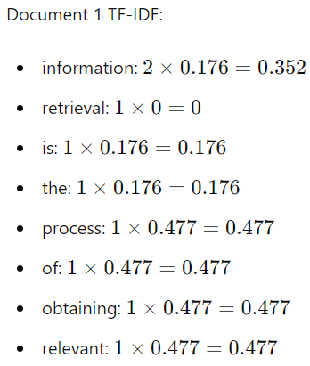
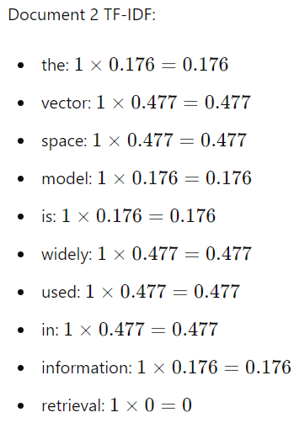
5. Calculate TF-IDF:
Multiply TF by IDF for each term in each document and query.
Document 3 TF-IDF:
retrieval: 1 x 0 = 0
search : 1 x 0.477 =0.477
engines : 1 x 0.477 =0.477
employ : 1 x 0.477 =0.477
various : 1 x 0.477 =0.477
models : 1 x 0.477 =0.477
for : 1 x 0.477 =0.477
efficient : 1 x 0.477 =0.477
Query Vector: TF-IDF
information =1 × 0.176 = 0.176
retrieval = 1 × 0 = 0
model = 1 × 0.477 = 0.477

Slide 53
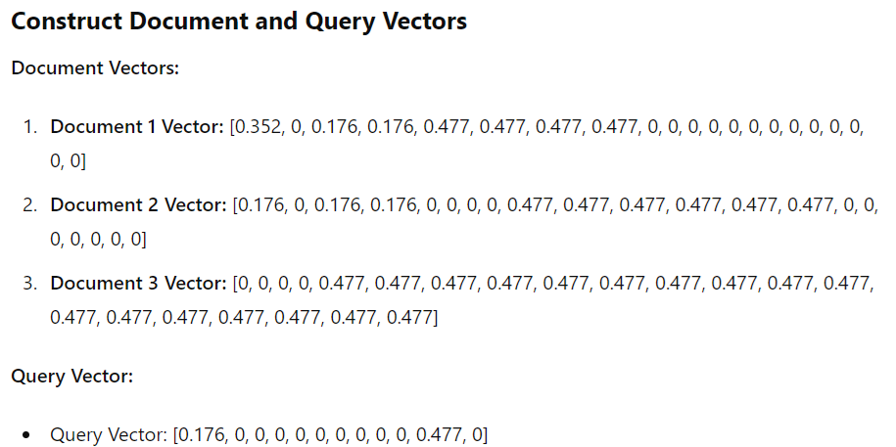
6.
0,0,0,0,0,0,0,0,0

Slide 54
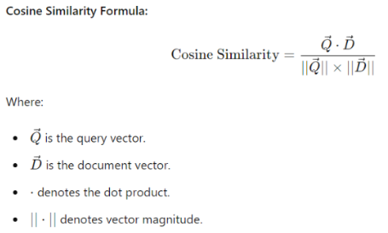

7. Calculate Cosine Similarity between query vector and each of document vectors

Slide 55
Step 8: Ranking Documents
Rank documents based on their cosine similarity scores. Higher similarity scores indicate higher relevance to the query "information retrieval model".
Document 1 and Query = 0.117
Document 2 and Query = 0.471
Document 3 and Query = 0.415
Document 2 has the highest cosine similarity with the query, indicating it is the most relevant document to the query "information retrieval model."

Slide 56
Vector Space Model : Advantages and Disadvantages
Advantages
Flexibility:
Handles partial matches and degrees of relevance through cosine similarity scores.
Can rank documents based on relevance rather than just binary (relevant or not).
Term Weighting:
Considers the importance of terms in both documents and queries, using TF-IDF to distinguish between frequent and important terms.
Efficiency:
Efficient retrieval using precomputed document vectors and fast cosine similarity calculations.
Disadvantages
Curse of Dimensionality:
As the number of unique terms (dimensions) increases, the vector space becomes sparse and computation-intensive.
Handling Synonyms and Polysemy:
Relies on exact term matching unless expanded with techniques like query expansion or semantic analysis.
Scalability:
Scaling to large document collections and queries can pose challenges due to the computational requirements of vector operations.

Slide 57


Example : Vector Space Model

Slide 58

Probabilistic IR Models

Slide 59

a: doc is relevant and a bar : a document is not relevant

Slide 60

Log of Odds Ratio
X is probability. logit(x)= prob of observed / prob of not observed

Slide 61

Initially user gives the query say (k1,k2)
IR system retrieves a set of documents say D1 to D5.
User will click on the document if he fills that it may be relevant.
He will not click the doc if he fills that it may not be relevant.
However it does not mean that if he don't click the doc, it is completely irrelevant document. Or if he clicks it is relevant.
Here we need to calculate prior prob and likelihood

Slide 63



Slide 64


Slide 65


Expression for Ranking Computations in Probabilistic IR Models:
Wi,q=weight factor of a term w.r.t query
Wi,j = weight factor of a term w.r.t document dj
These weight factors are binary in nature.

Slide 66



Query Q=(K1,K2)
Find Sim( D1,Q)

Slide 67



Query Q=(K1,K2)
Find Sim( D2,Q) ,Sim( D3,Q),Sim( D4,Q),Sim( D5,Q)

Slide 68


Find Sim( D4,Q) ,Sim( D5,Q)
Ranking: D2,D5,D4,D1,D3

Slide 69
Probabilistic IR Models : Advantages and Disadvantages
Advantages
Probabilistic Ranking:
Provides a probabilistic estimate of document relevance rather than binary (relevant or not) or similarity scores.
Can handle uncertainty and varying degrees of relevance more effectively.
Feedback Mechanisms:
Supports relevance feedback mechanisms where user interactions (e.g., clicks on retrieved documents) update the model's estimates.
Flexibility:
Can be adapted to different types of documents and queries by adjusting the probabilistic parameters and models.
Disadvantages
Complexity:
Implementing and tuning probabilistic models can be more complex than Boolean or Vector Space models.
Requires accurate estimation of probabilities and parameters, which may be challenging.
Assumptions:
Relies on assumptions such as conditional independence of terms given relevance, which may not always hold in practice.
Performance:
May require more computational resources compared to simpler models, especially for large-scale document collections.

Slide 70
Alternative Set Theoretic Model
Alternative Set Theoretic Information Retrieval (IR) models provide different approaches to retrieving information based on set theory principles, often complementing or expanding upon the traditional Boolean model.
A few notable alternatives includes:
Extended Binary Model (EBM)
Fuzzy Set Model

Slide 71
Extended Boolean Model
In Boolean retrieval as there is no provision for term weighting, no ranking of the answer set is generated. As a result, the size of the output might be too large or too small.
Because of these problems, modern information retrieval systems are no longer based on the Boolean model. In fact, most of the new systems adopt at their core some form of vector retrieval.
The reasons are that the vector space model is simple, fast, and yields better retrieval performance.
One alternative approach is to extend the Boolean model with the functionality of partial matching and term weighting. i.e EBM is based on the idea of extending the Boolean model with features of the vector model.
This strategy allows us to combine Boolean query formulations with characteristics of the vector model.

Slide 72

Extended Boolean Model: Formal Characterization

Slide 73



Slide 74


Slide 75


Slide 76



Keyword space Representation for AND and OR operators for two-term queries

Slide 77





For AND query,point (1,1) is the most desirable spot. This suggests taking the complement of the distance form (1,1) as a measure of similarity w.r.t AND query.Also such distances can be normalized.
For OR query,point (0,0) is the spot to be avoided. This suggests taking the distance form (0,0) as a measure of similarity w.r.t OR query. Also such distances can be normalized.

Slide 78
In EBM, even if some term is absent in doc, we get some similarity with AND query. So ranking is there. In simple BM, it will give 0 value i.e irrelevant document
In case of OR query , in SBM,there is no calibration even if one of the term is absent or both are present(in both, it gives 1). But in EBM is there. It gives some value other than 1
For AND query , we are taking the distance from (1,1) and for OR, from(0,0)

Slide 79

Generalized formula for Extended Boolean Operators

Slide 80



Problem with EBM?
Here X_{i} = w_{1,j} = Weight of K1 in D_{j}

Slide 81
Example: EBM
Doc1: "Information retrieval is the process of obtaining information from a large repository."
Doc2: "Information retrieval systems are used in digital libraries."
Doc3: "Boolean logic is a cornerstone of traditional information retrieval."
Doc4: "Extended Boolean models improve upon the classic Boolean retrieval approach."
Query
Suppose the query is: "(Information AND retrieval) OR systems"

Slide 82




Slide 83
Example Scenario: Imagine you are searching for information about artificial intelligence (AI) and its applications in healthcare. You are interested in finding documents that discuss AI in medical diagnostics and treatment.
Traditional Boolean Model:
Query: AI AND healthcare AND (diagnostics OR treatment)
In this model:
You must find documents that contain all the specified terms exactly as they appear in your query ("AI", "healthcare", "diagnostics", "treatment").
If a document doesn't have all these terms in the exact way you've specified, it will not be retrieved, even if it discusses related topics.
Extended Boolean Model (EBM): In this Model, your query could be expanded and weighted to better capture relevant documents:
Query: AI OR artificial intelligence AND healthcare OR medical AND (diagnostics OR treatment)
In this model:
The terms "AI" and "artificial intelligence" are treated as synonymous, so documents containing either term will be retrieved.
Similarly, "healthcare" and "medical" are considered related, broadening the scope of relevant documents.
The terms "diagnostics" and "treatment" are used with an OR operator, allowing documents that discuss either or both topics to be retrieved.

Slide 84
Additionally:
The EBM might assign weights to terms based on their relevance or importance. For example, if a document mentions "AI in medical diagnostics" multiple times, it might receive a higher relevance score than a document that briefly mentions "AI in healthcare".
Partial matches or synonyms (like "AI" and "artificial intelligence") can also be accounted for, improving the retrieval of documents that use different but related terms.

Slide 85
Advantages of EBM:
Improved Relevance: EBM allows for term weighting, meaning more relevant documents can be ranked higher based on the importance or frequency of query terms within them. This enhances the precision of search results by prioritizing documents that are more closely related to the query.
Partial Matching: Unlike the strict Boolean model, which requires exact matches between query terms and document content, EBM supports partial matching. This means documents containing variations or related terms to those in the query can still be retrieved, improving recall (the ability to retrieve relevant documents).
Synonym Handling: EBM can accommodate synonyms and related terms, broadening the scope of retrieval. For example, it can recognize "AI" and "artificial intelligence" as equivalent terms, ensuring that documents using either term are retrieved.
Flexibility in Query Construction: EBM allows for more complex queries using Boolean operators (AND, OR, NOT) and parentheses to combine terms and specify relationships between them. This flexibility enables users to construct more precise queries tailored to their information needs.
Conceptual Retrieval: By incorporating concepts and semantic relationships between terms, EBM can capture documents that are conceptually related to the query, even if they do not contain the exact terms specified. This enhances the overall effectiveness of information retrieval.

Slide 86
Disadvantages of EBM:
Complexity: Implementing and understanding EBM can be more complex compared to the traditional Boolean model. Users may need more training or expertise to construct effective queries and interpret search results correctly.
Computational Overhead: EBM involves more complex computations, such as term weighting and handling synonyms, which can increase computational overhead compared to the simpler Boolean model. This may affect the speed of retrieval in large-scale systems.
Risk of Over-retrieval: Because EBM allows for partial matches and synonym handling, there is a risk of retrieving too many irrelevant documents (over-retrieval). This can happen if the model is not properly tuned or if query terms are too broad or ambiguous.
Dependency on Quality of Indexing: EBM relies heavily on the quality of the indexing process, which involves assigning weights to terms and capturing semantic relationships. If indexing is not done well, retrieval effectiveness may be compromised.
User Training Required: Due to its complexity and flexibility, users may need training to fully utilize EBM's capabilities and construct effective queries. This could be a barrier in environments where users are not familiar with advanced search techniques.

Slide 87
Alternative Set Theoretic Model: Fuzzy Set Model

Slide 88

Fuzzy set Theory
The fuzzy set theory is an extension of the classical set theory designed to handle the concept of partial membership making it applicable in various fields where binary classification is insufficient..
In traditional set theory,membership is binary.
The fuzzy set theory deals with the representation of the classes whose boundaries are not well defined.
The key idea is to associate a membership function with the elements of the class.
This function takes the values in the interval [0,1].
Thus membership in fuzzy set is a intrinsically gradual instead of abrupt (as in conventional boolean logic)classic
Fuzzy set theory allows elements to have degrees of membership in a set, which is useful for dealing with uncertain or imprecise information.

Slide 89


Slide 90


Slide 91

Example: Fuzzy Algebra

Slide 92
Fuzzy Information Retrieval Model
A thesaurus in the context of fuzzy sets refers to a structured representation of terms that captures the relationships and degrees of similarity between them, allowing for more flexible and nuanced information retrieval.
The fuzzy set approach to a thesaurus enables the representation of synonyms, antonyms, and related(contextually) terms with varying degrees of membership, which can be particularly useful for enhancing search queries and improving retrieval accuracy.
The basic idea is to expand index terms in the query with related terms(obtained from the thesaurus) such that additional relevant documents(i.e besides the ones that would be normally retrieved) can be retrieved by the user query.

Slide 93


Slide 94



Fuzzy Information Retrieval Model

Slide 95

Example

Slide 96


Slide 97



The correlation matrix c can be used to define fuzzy set associated to each index term Ki. In this fuzzy set , the document Dj has a degree of membership
Degree of membership of document Dj in the fuzzy set associated to index term Ki
Multiplication of (1-c_{i,l})
⅔ * ⅔ * 1*1 =4/9

Slide 98



Slide 100



Slide 101



Slide 102



Slide 103


Slide 104


Fuzzy Set Model Advantages and Disadvantages:

Slide 105
Applications of Fuzzy Set Model
Information Retrieval: Fuzzy set models can handle imprecise queries and rank documents based on the degree of relevance.
Control Systems: Fuzzy logic controllers are used in systems where precise control is difficult, such as automatic transmission systems and climate control.
Decision Making: Fuzzy set theory is used in multi-criteria decision making where criteria and alternatives are not sharply defined.
Pattern Recognition: Fuzzy sets can model and classify data that are not crisply defined.

Slide 106

Query: step, man, mankind china

Slide 107


Slide 108


Slide 109


Slide 110


Slide 111


Slide 112


Slide 113


Slide 114
Suppose that a user remembers that the document he is interested in contains the page
Here , user would like to express his query using a more richer expression such as —- which conveys the details in his visual recollection

Slide 115


Slide 116


Slide 117


Slide 118


Slide 119


Slide 120
To allow searching for index terms and for text regions, a single inverted file is built in which each structural component stands as an entry in the index.
Associated with each entry, there is a list of text regions as a list of occurrences.
Moreover, such a list could be easily merged with the traditional inverted file for the words in the text.
Since the text regions are non-overlapping, the types of queries which can be asked are simple:
(a) select a region which contains a given word (and does not contain other regions);
(b) select a region A which does not contain any other region B (where B belongs to a list distinct from the list for A);
(c) select a region not contained within any other region, etc.

Slide 121
Key Concepts of Non-Overlapping Lists Structured Retrieval Model
Document Segmentation:
Non-Overlapping Segments: Documents are divided into distinct, non-overlapping segments or lists. Each segment might represent a different logical part of the document, such as chapters, sections, or specific fields (e.g., title, abstract, body).
Independence of Segments: Since the segments do not overlap, each one is treated as an independent entity during retrieval. This allows for more precise matching of queries to specific parts of the document.
Indexing Process:
Separate Indexes for Each Segment: Each segment or list is indexed separately. For instance, in an academic paper, there would be separate indexes for the title, abstract, introduction, and conclusion.
Field-Specific Terms: The terms within each segment are only associated with that specific segment in the index, ensuring that searches within a segment do not inadvertently retrieve content from another segment.
3. Query Representation:
Segment-Specific Queries: Queries can be directed at specific segments. For example, a user might want to search only within the "Abstract" or "Conclusion" sections of documents.
Fielded Queries: Users can specify which part of the document they are interested in by using fielded queries (e.g., abstract: "information retrieval"). This directs the retrieval process to consider only the relevant segment.

Slide 122
4. Retrieval Process:
Independent Scoring: Each segment of the document is scored independently based on its relevance to the query. The overall document score can then be a combination of these individual segment scores, often using a weighted sum.
Non-Overlapping Contribution: Since the segments do not overlap, the relevance of one segment does not directly influence the relevance score of another, ensuring that each part of the document contributes distinctly to the final score.
5. Aggregation of Results:
Combining Segment Scores: The final retrieval score for a document is an aggregation of the scores from the relevant segments. Depending on the application, different segments might be weighted differently based on their importance.
Result Presentation: Retrieved documents might be presented with highlights or excerpts from the specific segments that matched the query, making it clear which part of the document is relevant.

Slide 123
Example Application: academic paper retrieval.
Scenario
You are designing a search engine for an academic database that contains research papers. Each paper is divided into non-overlapping sections: Title, Abstract, Introduction, Methodology, Results, Conclusion, and References. Users of the system often have specific information needs that pertain to particular sections of these papers.
Document Structure and Indexing
Each academic paper is divided into the following non-overlapping segments:
Title
Abstract
Introduction
Methodology
Results
Conclusion
References
For each paper, these segments are independently indexed. This means:
The Title field is indexed separately, allowing for searches that specifically target the paper's title.
The Abstract is indexed as a separate segment, so users can search within the abstracts across multiple papers.
The Introduction, Methodology, Results, Conclusion, and References are each independently indexed.

Slide 124
Example Document
Consider the following simplified academic paper:
Title: "Advances in Information Retrieval Techniques"
Abstract: "This paper reviews recent advances in information retrieval, focusing on machine learning algorithms."
Introduction: "Information retrieval has become a critical field with the growth of the internet. Traditional methods have limitations that modern techniques seek to overcome."
Methodology: "We applied a support vector machine (SVM) classifier to a dataset of 10,000 documents to evaluate retrieval accuracy."
Results: "Our SVM-based approach achieved a 15% improvement in retrieval precision over baseline methods."
Conclusion: "The study demonstrates that machine learning algorithms significantly enhance information retrieval performance."
References: A list of cited papers and books.
Indexing Process
Each segment is treated as an independent entity during indexing:
Title Index: "Advances in Information Retrieval Techniques"
Abstract Index: "This paper reviews recent advances in information retrieval, focusing on machine learning algorithms."
Introduction Index: "Information retrieval has become a critical field..."
Methodology Index: "We applied a support vector machine (SVM)..."
Results Index: "Our SVM-based approach achieved a 15% improvement..."
Conclusion Index: "The study demonstrates that machine learning algorithms..."
References Index: (Each reference is indexed separately.)

Slide 125
Query Example 1: Simple Query Targeting a Specific Segment
A researcher is interested in finding papers that have applied Support Vector Machines (SVMs) in the Methodology section.
The researcher uses the following query: methodology: "Support Vector Machines"
Retrieval Process:
Search Within the Methodology Segment: The retrieval model searches only within the Methodology segments of all indexed papers.
Independent Scoring: Each document's Methodology section is scored based on its relevance to the query "Support Vector Machines."
Result Ranking: Documents are ranked based on the score derived from their Methodology segment. Only those papers where the Methodology explicitly mentions "Support Vector Machines" will be retrieved.
Result:
The paper mentioned on previous slide (No 118) would be retrieved because its Methodology segment includes "We applied a support vector machine (SVM)..."

Slide 126
Summary
A structured retrieval model based on non-overlapping lists provides a highly structured and precise approach to information retrieval, particularly suited to domains where documents have well-defined, independent sections. By treating each segment as an independent entity, this model ensures that retrieval is focused and relevant, providing clear and interpretable results to users.

Slide 127

Summary
A structured retrieval model based on non-overlapping lists provides a highly structured and precise approach to information retrieval, particularly suited to domains where documents have well-defined, independent sections. By treating each segment as an independent entity, this model ensures that retrieval is focused and relevant, providing clear and interpretable results to users.

Slide 128
Query Example 2: Complex Query with Multiple Segments
A researcher is interested in papers that discuss machine learning algorithms in the Abstract and also provide significant findings in the Results section.
The query: abstract: "machine learning algorithms" AND results: "significant findings"
Retrieval Process:
Search Within the Abstract Segment: The retrieval model first searches within the Abstract segments of all indexed papers for the phrase "machine learning algorithms."
Search Within the Results Segment: It then searches within the Results segments for the phrase "significant findings."
Independent Scoring and Aggregation:
Each document's Abstract and Results segments are scored independently.
The final relevance score for each document is an aggregation (e.g., weighted sum) of the individual scores from the Abstract and Results segments.
Result:
The paper on previous slide (No 118) would be retrieved because:
The Abstract mentions "machine learning algorithms."
The Results indicate significant findings, stating, "Our SVM-based approach achieved a 15% improvement in retrieval precision."

Slide 129
Advantages and Challenges:
Advantages of Non-Overlapping Lists Model
Precision: By ensuring that each segment is independent, this model allows for highly precise retrieval, targeting exactly the part of the document relevant to the query.
Clarity: Since the retrieval is based on non-overlapping segments, users can easily understand which part of the document is relevant, making it easier to interpret results.
Scalability: This approach scales well in structured environments, such as legal or academic databases, where documents naturally lend themselves to segmentation.
Challenges
Complexity of Query Formulation: Users need to be familiar with the document structure to effectively formulate queries targeting specific segments.
Segment Weighting: Determining appropriate weights for different segments can be challenging and might require domain-specific knowledge or user feedback.

Slide 130
Structured Retrieval Models based on Proximal Nodes
Structured retrieval models based on proximal nodes involve a sophisticated approach to information retrieval (IR) that enhances traditional models by considering the proximity of relevant nodes (or terms) within a document or database.
This method focuses not only on the occurrence of individual terms but also on their co-occurrence and relative positions, thus improving the relevance and accuracy of search results.
Key Concepts:
Proximal Nodes: These are points or locations within a document or dataset that are close to each other and contain related information. The proximity is typically measured in terms of distance within the text or graph, such as the number of words, sentences, or links between terms.
Structured Retrieval Models: These models extend the traditional IR models (like vector space models or probabilistic models) by incorporating structured data such as graphs, trees, or sequences that represent the relationship between different elements. This structure allows the model to consider the connections and proximity between nodes.

Slide 131
Key Concepts:
Proximity-Based Scoring: The core idea behind these models is that the closer the relevant nodes (terms) are to each other, the more likely the document is to be relevant to the query. For example, if two search terms appear close together in a document, that document may be ranked higher because it's more likely to address the query's intent.
Graph-Based Retrieval: One common approach is to represent documents and queries as graphs where nodes represent terms or concepts, and edges represent relationships or proximity. The retrieval process then involves searching for subgraphs or patterns within these graphs that match the query.
Query Expansion: Structured retrieval models often involve query expansion techniques where the original query is enhanced by adding related terms or concepts that are connected through the graph structure. This can improve the retrieval of relevant documents that might not contain the exact query terms but are semantically related.
Applications: These models are particularly useful in domains where relationships between concepts are crucial, such as biomedical literature retrieval, legal document analysis, or any context where the structure of information plays a significant role.

Slide 132
Example: Legal Document Retrieval Using Structured Retrieval Models Based on Proximal Nodes
Scenario: A legal researcher is investigating how "trade secrets" are protected under "non-compete agreements" in the context of "intellectual property" law.
Data Representation:
Document Collection:
The corpus consists of legal documents, such as court cases, legal analyses, and statutes, where terms related to "trade secrets," "non-compete agreements," and "intellectual property" might appear.
Graph Construction:
Each legal document is transformed into a graph. Here’s how this works:
Nodes: Key legal concepts or terms are identified and treated as nodes. In this case, terms like "trade secrets," "non-compete agreements," and "intellectual property" become nodes.
Edges: Relationships between these nodes are represented by edges. The weight of an edge reflects the proximity of these terms within the document:
Sentence-level proximity: Terms appearing within the same sentence have the highest proximity score.
Paragraph-level proximity: Terms appearing in the same paragraph but different sentences have a slightly lower proximity score.
Section-level proximity: Terms appearing in the same section or chapter have the lowest proximity score.

Slide 133
3. Example Document Graph:
Suppose we have a legal document with the following relevant excerpt:
Paragraph 1: "Intellectual property rights often intersect with trade secrets. A non-compete agreement can protect these secrets by restricting former employees from joining competitors."
Paragraph 2: "In cases involving intellectual property, courts have upheld the use of non-compete agreements to prevent the misuse of trade secrets."
This document would be represented as a graph:
Nodes: "Intellectual property," "trade secrets," "non-compete agreements"
Edges:
High-weight edge between "intellectual property" and "trade secrets" within Paragraph 1 (sentence-level proximity).
High-weight edge between "trade secrets" and "non-compete agreements" within Paragraph 1 (sentence-level proximity).
Medium-weight edge between "intellectual property" and "non-compete agreements" (paragraph-level proximity).
Another set of edges for the relationships in Paragraph 2, reinforcing the connections.

Slide 134
Query Processing:
The legal researcher’s query is: "How are trade secrets protected under non-compete agreements within the framework of intellectual property law?"
1. Query Representation:
The query is represented as a set of nodes: "trade secrets," "non-compete agreements," and "intellectual property."
Since the query specifically asks about "protection," we might include a node for "protection" as well, though it would be connected to the main nodes with a lower weight unless it appears in the same context.
2. Subgraph Matching:
The retrieval model searches for subgraphs within the document graphs that match the structure of the query graph.
It looks for clusters of nodes where "trade secrets," "non-compete agreements," and "intellectual property" are closely connected, with higher weights assigned to those connections.

Slide 135
3. Scoring and Ranking:
Proximity Scoring:
Documents where these concepts appear in close proximity (e.g., within the same paragraph or sentence) are scored higher.
If "protection" appears in conjunction with the key terms in a relevant context, this increases the score.
Contextual Relevance:
If a document specifically discusses how "non-compete agreements" protect "trade secrets" as a form of "intellectual property," it would receive a higher score due to the direct relevance.
Detailed Example Output:
Top-Ranked Document:
Document Excerpt: "In a landmark case, the court ruled that non-compete agreements are essential for protecting trade secrets, especially when they are considered part of a company’s intellectual property portfolio. The court highlighted that the proximity of an employee's knowledge of trade secrets to their subsequent employment poses a significant risk to the intellectual property of the original employer."
Proximity Analysis:
Nodes: "trade secrets," "non-compete agreements," "intellectual property"
Edges: Strong edges connecting all three terms within the same sentence.
Score: High, due to the strong, direct connections.

Slide 136
Moderately Ranked Document:
Document Excerpt: "The enforcement of non-compete agreements can vary, but they are often used to protect trade secrets. However, the definition of what constitutes intellectual property in these cases can be complex."
Proximity Analysis:
Nodes: "trade secrets," "non-compete agreements," "intellectual property"
Edges: Moderate edges with terms appearing in the same paragraph but not the same sentence.
Score: Moderate, due to relevant but less tightly connected content.
Low-Ranked Document:
Document Excerpt: "Trade secrets and intellectual property law are vital for businesses. Non-compete agreements are another legal tool used in employment contracts."
Proximity Analysis:
Nodes: "trade secrets," "intellectual property," "non-compete agreements"
Edges: Weak or non-existent connections between the nodes (terms mentioned separately without clear relationships).
Score: Low, due to the lack of proximity and direct connection between the terms.
Conclusion:
In this example, the structured retrieval model effectively identifies and ranks documents based on the proximity and context of key legal concepts. It goes beyond mere keyword matching by considering how closely related the terms are within the text, thus providing more relevant and contextually accurate search results for the legal researcher.

Slide 137
Advantages and Challenges:
Advantages:
Enhanced Relevance: By considering the proximity of related terms, these models can improve the accuracy of search results, especially for complex queries.
Context-Aware: The use of structured data allows the model to understand and utilize the context in which terms appear, leading to more meaningful retrieval.
Flexibility: These models can be adapted to various types of structured data, such as text, graphs, or even semi-structured data like XML.
Challenges:
Complexity: Implementing and computing proximity-based models can be computationally expensive, especially for large datasets.
Data Structure Dependency: The effectiveness of these models heavily depends on the quality and structure of the underlying data, which may not always be well-defined or consistent.

Slide 138


Slide 139


Slide 140


Slide 141
Reading Link : Models for browsing

Slide 142


Slide 143
Extensions of Vector Space Models:Alternative Algebraic Models
While the basic vector space model represents text or data as vectors in a high-dimensional space, several extensions and modifications have been developed to address the limitations of the original model and to better capture the complexities of the data.
Here are some notable extensions:
Generalized VSM
Latent Semantic Indexing(LSI)
Neural Networks Model
Reading Link: Alternative Algebraic Models

